Slide 1
Time Series Analysis
Basics of Time Series Analysis
Nicoleta Serban, Ph.D.
Associate Professor
Stewart School of Industrial and Systems Engineering
Decomposition: Seasonality Estimation Data Examples

Slide 2
About this lesson

Slide 3
Data Example: Temperature in Atlanta, Georgia
Data: Average monthly temperature records starting in 1879 until 2016.
Available from the iWearherNet.com
The Weather Bureau (now the National Weather Service) began keeping weather records for Atlanta 138 years, 8 months and 19 days ago on October 1, 1878.
Provided in Fahrenheit degrees
Is there seasonality and trend in temperature in Atlanta?

Slide 4
Seasonality: Seasonal Models
library(TSA)
## Estimate seasonality using Seasonal Means Model
month = season(temp)
## Drop January/with intercept
model1 = lm(temp~month)
summary(model1)
## Seasonal mean effects/without intercept
model2 = lm(temp~month-1)
summary(model2)
## Estimate seasonality using cos-sin model
har1=harmonic(temp,1)
model3=lm(temp~har1)
summary(model3)
har2=harmonic(temp,2)
model4=lm(temp~har2)
summary(model4)

Slide 5
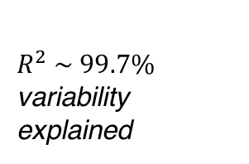
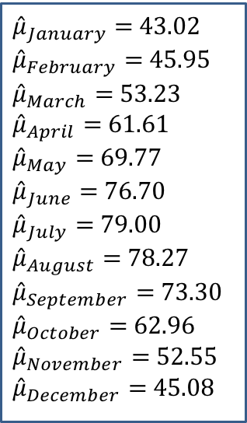
Seasonality: Seasonal Means Model
${\hat{μ}}_{January}=$ 43.02
${\hat{μ}}_{February}=$ 45.95
${\hat{μ}}_{March}=$ 53.23
${\hat{μ}}_{April}=$ 61.61
${\hat{μ}}_{May}=$ 69.77
${\hat{μ}}_{June}=$ 76.70
${\hat{μ}}_{July}=$ 79.00
${\hat{μ}}_{August}=$ 78.27
${\hat{μ}}_{September}=$ 73.30
${\hat{μ}}_{October}=$ 62.96
${\hat{μ}}_{November}=$ 52.55
${\hat{μ}}_{December}=$ 45.08
Estimate Std. Error t value Pr(>|t|)
monthJanuary 43.2072 0.2725 158.5 <2e-16
monthFebruary 45.9587 0.2725 168.6 <2e-16
monthMarch 53.2304 0.2725 195.3 <2e-16
monthApril 61.6087 0.2725 226.1 <2e-16
monthMay 69.7696 0.2725 256.0 <2e-16
monthJune 76.6986 0.2725 281.4 <2e-16
monthJuly 79.0051 0.2725 289.9 <2e-16
monthAugust 78.2703 0.2725 287.2 <2e-16
monthSeptember 73.2986 0.2725 268.9 <2e-16
monthOctober 62.9616 0.2725 231.0 <2e-16
monthNovember 52.5493 0.2725 192.8 <2e-16
monthDecember 45.0725 0.2725 165.4 <2e-16
Multiple R-squared: 0.9975, Adjusted R-squared: 0.9974
$R^{2} \sim 99.7\%$ variability explained

Slide 6
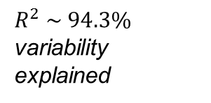
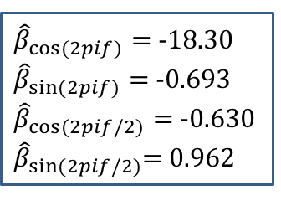
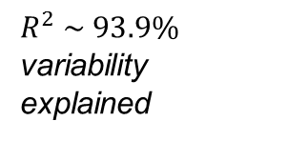
Seasonality: Cos-Sin Model
Estimate Std. Error t value Pr(>|t|)
(Intercept) 61.80254 0.08133 759.870 < 2e-16
har2cos(2*pi*t) -18.30228 0.11502 -159.119 < 2e-16
har2sin(2*pi*t) -0.69366 0.11502 -6.031 2.01e-09
Multiple R-squared: 0.9388, Adjusted R-squared: 0.9387
$R^{2} \sim 93.9\%$ variability explained
Estimate Std. Error t value Pr(>|t|)
(Intercept) 61.80254 0.07888 783.490 < 2e-16
har2cos(2*pi*t) -18.30228 0.11155 -164.065 < 2e-16
har2cos(4*pi*t) -0.63031 0.11155 -5.650 1.88e-08
har2sin(2*pi*t) -0.69366 0.11155 -6.218 6.36e-10
har2sin(4*pi*t) 0.96246 0.11155 8.628 < 2e-16
Multiple R-squared: 0.9425, Adjusted R-squared: 0.9424
${\hat{β}}_{cos⁡(2pif)}=$ -18.30
${\hat{β}}_{sin⁡(2pif)}=$ -0.693
${\hat{β}}_{cos⁡(2pif/2)}=$ -0.630 ${\hat{β}}_{sin⁡(2pif/2)}$= 0.962
$R^{2} \sim 94.3\%$ variability explained

Slide 7
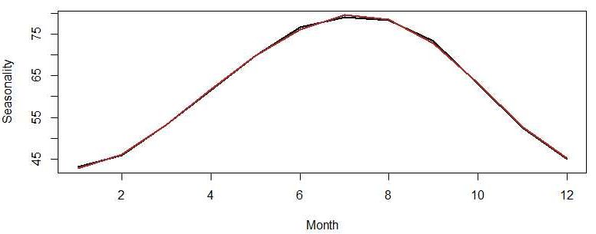
Seasonality: Compare Models
## Seasonal Means Model
st1 = coef(model2)
## Cos-Sin Model
st2 = fitted(model4)[1:12]
## Compare Seasonality Estimates
plot(1:12,st1,lwd=2,type="l",xlab="Month",ylab="Seasonality")
lines(1:12,st2,lwd=2, col="brown")

Slide 8
Seasonality & Trend: Parametric Model
## Fit a parametric model for both trend and seasonality
x1 = time.pts
x2 = time.pts^2
har2=harmonic(temp,2)
lm.fit = lm(temp~x1+x2+har2)
summary(lm.fit)
dif.fit.lm = ts((temp-fitted(lm.fit)),start=1879,frequency=12)
ts.plot(dif.fit.lm,ylab="Residual Process")

Slide 9
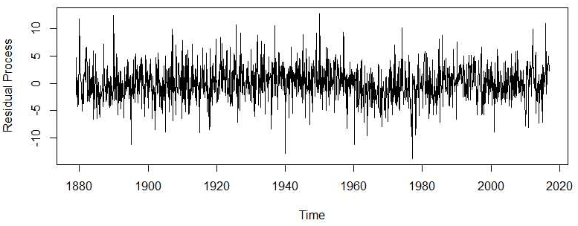
Seasonality & Trend: Parametric Model

Slide 10
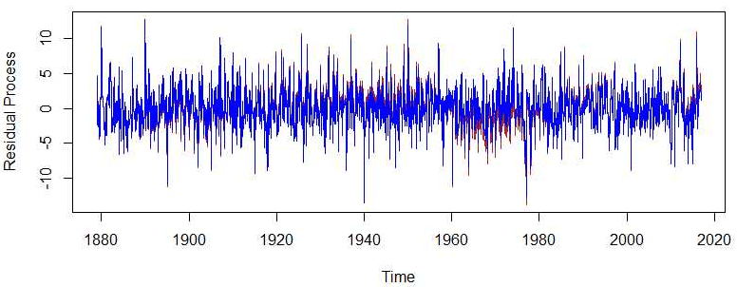
Seasonality & Trend: Compare Model
## Fit a non-parametric model for trend and linear model for seasonality
gam.fit = gam(temp~s(time.pts)+har2)
dif.fit.gam = ts((temp-fitted(gam.fit)),start=1879,frequency=12)
## Compare approaches
ts.plot(dif.fit.lm,ylab="Residual Process",col="brown")
lines(dif.fit.gam,col="blue")

Slide 11
Summary

